Slide 1
Rate/Congestion Control for Multimedia Streaming

Slide 2
Multimedia streams requirements
Network requirements:
  high bandwidth demands (uncompressed HDTV with a resolution of 1280x720 requires a bandwidth of 648 Mbit/s)
  isochronous communication
End-user system requirements:
  high demands in computing power (CPU, memory, transfer speed, ..)
  great storage capacities (2 hours of uncompressed HDTV movie eats approximately 570 GB)

Slide 3
Problems of multimedia streams in best-effort networks
no QoS guarantees can be given in a best-effort network (IP-based network)
varying available bandwidth, delay, jitter
packets are lost due to congestion onset
applications must continuously adapt to varying network conditions

Slide 4
What is Congestion Control ?
Congestion - occurs when the number of packets entering the network surpass the capacity of the network (link's bandwidth)
Effects of Congestion:
  drastic drop of the quality of service provided by the network
  packets get lost inside routers, so bandwidth is wasted (up to that router)
  RTT increases
  little work is done by the network (goodput drops down)
Congestion Control – controlling the load applied on the network (the number of packets sent into the network) so that congestion (packet losses) does not occur:
  congestion control can happen in an “end-2-end” way (like TCP)
  congestion control can happen inside routers (Active Queue Management - AQM)

Slide 5
Why is Congestion Control needed ?
to avoid congestion collapse
to be fair to other network citizens
ultimately, to provide reasonable good service for the receiver and all other network citizen

Slide 6
End-2-end Congestion Control
increasing the transmission rate when the network becomes underutilized
decreasing the transmission rate when the network gets congested (overutilized)

Slide 7
TCP (Transmission Control Protocol)
is a reliable, robust transport protocol
has bit-stream semantics
is reliable (if packet loss is detected, the packet is retransmitted)
assures in-order packet delivery
performs congestion control (AIMD – Additive Increase Multiplicative Decrease)
is responsible for 90% of the Internet traffic

Slide 8
TCP’s AIMD
At each acknowledgment receipt:
IF (cwnd < ssthresh) // slow-start
cwnd += 1;
ELSE // AIMD
cwnd += 1/cwnd; // additive increase (one packet per cwnd/RTT)
At each packet loss detection:
IF (cwnd < ssthresh OR packet_loss_detected_with_timeout) // slow-start
cwnd = 1;
ssthresh = ssthresh/2;
ELSE // AIMD, Fast Retransmit
cwnd = cwnd/2; // multiplicative decrease

Slide 9
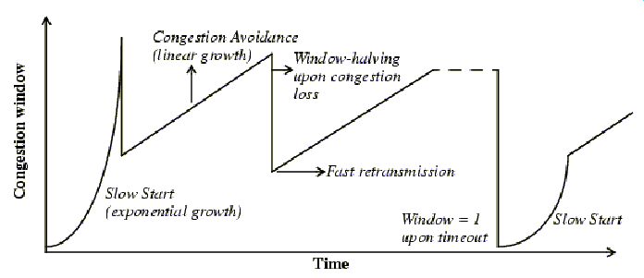
AIMD transmission rate

Slide 10
TCP not suitable for multimedia streaming
TCP Additively Increases and Multiplicatively Decreases its throughput (i.e. its view of the available bandwidth) ; has a “saw-tooth” highly fluctuating transmission rate which is not good for multimedia streaming:
TCP trades timeliness of data for reliability
tcp-friendly flow = its long-run average transmission rate does not exceed the transmission rate of a TCP flow under the same network conditions
TFRC (TCP-Friendly Rate Control) has a smoother variation of throughput:

Slide 11
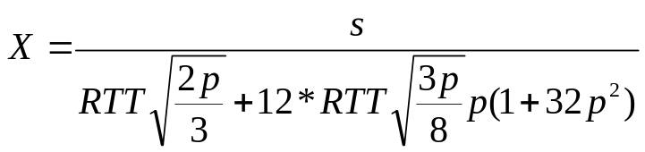
TCP-Friendly Rate Control (TFRC)
does not respond in a fixed fashion to each packet loss, but to the loss event rate measured over some interval of time
it shows on time scales of several RTTs roughly the same throughput as a TCP flow in steady-state when the available bandwidth does not change with time
obtains a smoother send rate than TCP
is slow responsive to congestion
is less aggressive than TCP
TCP Reno throughput equation:
X – rate (throughput) in bytes/sec
RTT – the round-trip time
s – packet size
p – loss rate

Slide 12
TCP-Friendly Rate Control (2)
TFRC is a rate-based congestion control mechanism with 2 components:
the TCP-Reno throughput function – responsible for TCP-friendliness
the WALI mechanism for computing the loss event rate, p (i.e. p is a Weighted Average over the last 8 Loss Intervals) – responsible for throughput smoothness

Slide 13
TFRC and multimedia streaming
Advantages:
  TFRC provides a smoother throughput (than TCP) thus supporting better QoS predictability
  Reacts to congestion
Drawbacks:
  Cares only about network parameters (i.e. is network-friendly, but not so much media-friendly)
Video codecs output a variable bitrate in order to keep quality relatively constant (e.g. in MPEG4 the bitrate can increase 10-20 times between scenes)
=> we want a throughput that is TCP-friendly but follows the (slope) bitrate of the stream

Slide 14

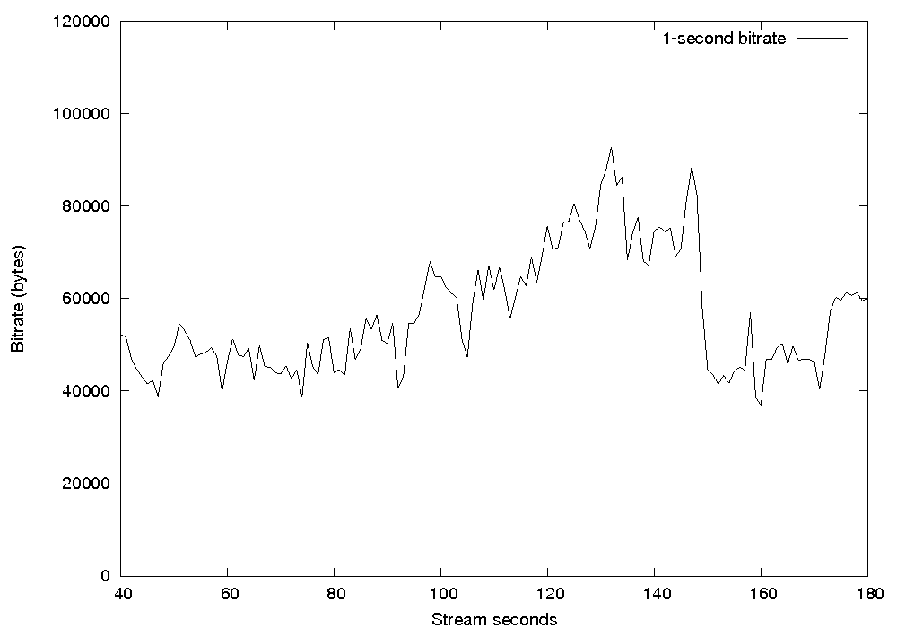
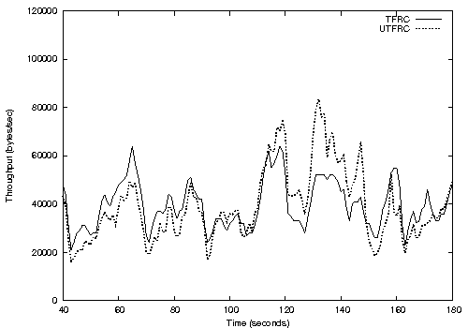
UTFRC – Utility-driven TCP-Friendly Rate Control
UTFRC’s transmission rate is:
where U(q(t)) є [0.8,1.2] is the utility function (i.e. media characteristic function)
Is TCP-Friendly and media-friendly
The bitrate of an MPEG-4 stream Transmission rate modified by UTFRC

Slide 15
DCCP – Datagram Congestion Control Protocol
is a full-fledged transport protocol for unreliable datagrams with congestion control it is intended as a replacement of UDP for multimedia streaming applications
DCCP is a transport protocol that implements bidirectional, unicast connections of congestion-controlled, unreliable datagrams. As, specified in the RFC ([18]), DCCP can be thought of as TCP without bytestream semantics and reliability or as UDP with congestion control, handshakes and acknowledgements.
As oposed to UDP, DCCP is connection-oriented. Data can flow in both directions in a DCCP connection. DCCP uses acknowledgements to detect packet losses. Each DCCP packet (including the acknowledgements) has a unique sequence number for detecting and reporting packet losses. However, unlike in TCP, DCCP's sequence numbers are packet-based, not byte-based (i.e. every packet sent increments with 1 the sequence number).
A DCCP packet starts with a generic header. DCCP supports different types of congestion control and partners can choose the appropriate congestion control mechanism through negotiation. The protocol also offers a set of features which can be negotiated by the two partners at any time. There are two basic operations for negotiating and agreeing on a feature: change and confirm.

Slide 16
A DCCP connection
Before DCCP partners can communicate, they must establish a connection using a three-way handshake. A DCCP connection is established between two endpoints: one active that initiate the connection (client) and one passive that listen for connections (server). Packets (data packets and acknowledgements) flow in both directions into this connection.
Logically, the DCCP connection is made out of two independent half-connections. One half-connection runs from client to server and the other one runs from server to client. Each half-connection consists of the application data sent by one point and the acknowledgements sent by the other point. In practice however, the two half-connection overlap. A DCCP packet that contains data from one half-connection and acknowledgement from the other half-connection can be transmitted.

Slide 17
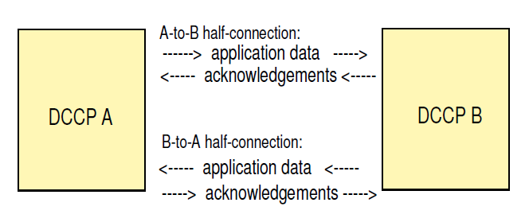
A DCCP connection (2)

Slide 18
DCCP packet format
DCCP uses 10 types of packets: DCCP-Request, DCCP-Response, DCCP-Data, DCCP-Ack, DCCP-DataAck, DCCP-CloseReq, DCCP-Close, DCCP-Reset, DCCP-Sync, DCCP-SyncAck.
The general structure of all DCCP packets consists of: a 12 or 16-bytes generic header, additional fixed-length fields depending on packet's type, optional options and application data (for DCCP-Data and DCCP-DataAck packets).

Slide 19
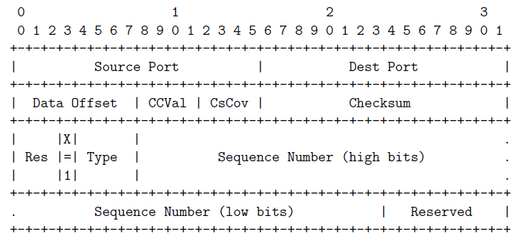
DCCP packet header (X=1)

Slide 20
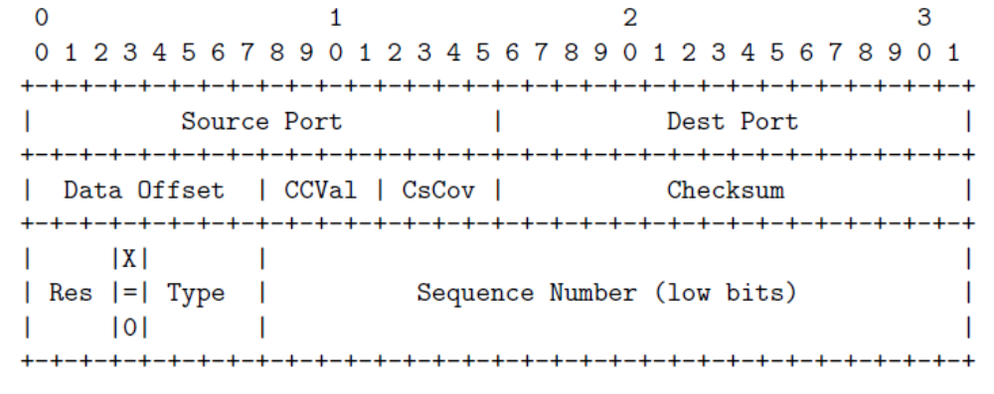
DCCP packet header (X=0)

Slide 21
DCCP header fields
Source port: 16 bit field that specifies the source port number (same meaning as in TCP)
Destination port: 16 bits field that specifies the destination port number (same meaning as in TCP)
Data Offset: 8 bit field, specifies the offset from the start of the DCCP header to the beginning of the packet's application data, in 32-bit words
CCVal: 4 bit field, a 4 bit congestion control data that has a meaning specific to the congestion control algorithm negotiated; only the passive endpoint of a half-connection may set the CCVal field and only if the congestion control algorithm allows it
CsCov: Checksum Coverage, 4 bit field, determines the parts of the packet that are covered by the Checksum field
Checksum: 16 bit field, the checksum of the packet's DCCP header, a network-layer pseudoheader, and, depending on CsCov, some or all of the application data.
Type: 4 bit field, specifies the type of the packet: 0 (DCCP-Request), 1 (DCCP-Response), 2 (DCCP-Data), 3 (DCCP-Ack), 4 (DCCP-DataAck), 5 (DCCP-CloseReq), 6 (DCCP-Close), 7 (DCCP-Reset), 8 (DCCP-Sync), 9 (DCCP-SyncAck), 10-15 reserved.
Res: 3 bit reserved field.
Extended Sequence Numbers (X): 1 bit field, set to one for 48-bit Sequence and Acknowledgement Numbers.
Sequence Number: 24 or 48 bit field, uniquely identifies he packet among all the packets sent by the same source in the current DCCP connection.

